Slide 1
THRIVE’26
FollowUp AI
Predict. Explain. Prioritize. Intervene.

Slide 2
Missed Follow-ups Cost
When a follow-up is missed, treatment is delayed, and patient outcomes worsen. Delays ripple through care plans, increasing risk and reducing the chance of remission or timely intervention. Operationally, clinics triage thousands of follow-ups monthly, and manual review misses who needs care now, wasting clinician time and precious resources.

Slide 3
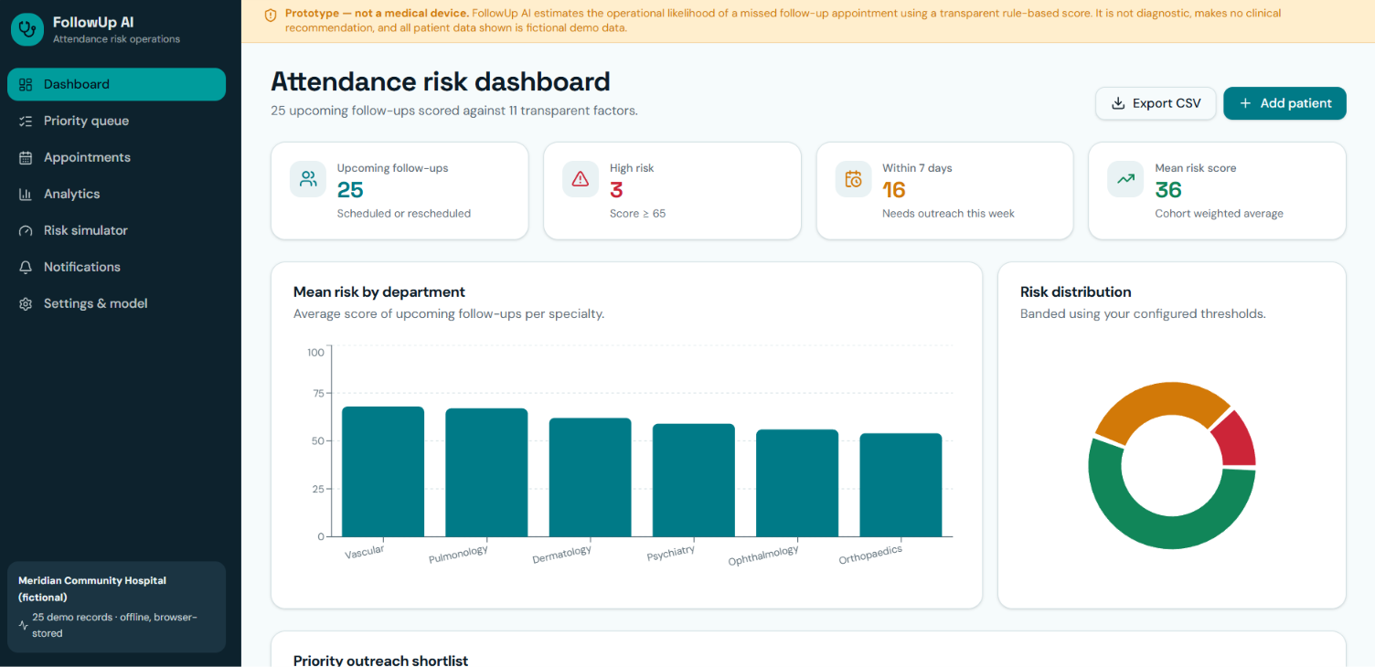
Missed Follow-Ups Impact
12%
Average missed follow-ups rate in comparable clinics.
3×
Higher dropout risk for patients with ≥2 missed visits.
Missed follow-ups translate to worse outcomes and tangible costs across care delivery.
120 staff‑
Hours spent by admin outreach per 1,000 follow-ups to attempt contact.

Slide 4
Predictive, Explainable Wins
Calendar views plus manual outreach drive follow-ups, but with limited precision and low trust. Outreach is reactive, often missing high-risk patients and wasting staff time.
A risk score with feature-level explanations guides proactive outreach. A prioritized queue focuses on the patients most likely to miss visits, boosting staff confidence and efficiency. Example: 200 upcoming visits in calendar vs. AI surfacing the top 40 patients responsible for ~75% of expected no‑
Predictive risk with explanations enables proactive, trusted follow-up.

Slide 5
Operational Inputs
Prev history
Missed shows
Distance
Treatment duration
Appointment cadence
Age factor
Attendance patterns and variability from past visits; operational, non-sensitive trend data (e.g., P-1024 shows variable attendance).
Count of prior no-shows; high weight among inputs; reflects historical access and reliability (e.g., P-1024 = 4).
Approximate patient distance from hospital; operational geography data (e.g., P-1024 = 31 km).
Months on active therapy; continuity indicator (e.g., P-1024 = 8 months).
Cadence of follow-ups and scheduling rhythm (e.g., P-1024 = weekly).
Age as a minor contributor in prototype (e.g., P-1024 = 68).

Slide 6
Explainable Risk
Risk score
0–29 Low, 30–59 Medium, 60–100 High; high band triggers proactive outreach.
72
Missed appointments
Primary lever: 4 misses in 12 months.
+40
Distance
Adds to score based on travel burden.
+11

Slide 7
Pilot Timeline
01
02
03
Integrate Feed
Triage High‑Risk
Measure Outcomes
Connect appointment data for one clinic and start a 6-week prediction window.
Identify the top 200 predicted high-risk patients for targeted outreach with recommended interventions.
Track missed-visit reductions, time saved per 1,000 appointments, and staff acceptance.

Slide 8
Pilot to Prove Value
- Run a 6-week pilot in one clinic; integrate FollowUp AI with appointment data.
- Triage the top 200 predicted high-risk patients for targeted outreach.
- Measure missed-visit reductions and operational time saved to quantify ROI.

Slide 9
THANKS!
Do you have any questions?
youremail@freepik.com
+91 620 421 838
yourwebsite.com
Please keep this slide for attribution

